Slide 1
IT IS EXACTLY
14:06

Slide 2
ORCHIDS
and thoughts for this moment...
Music: Autumn Rose

Slide 3
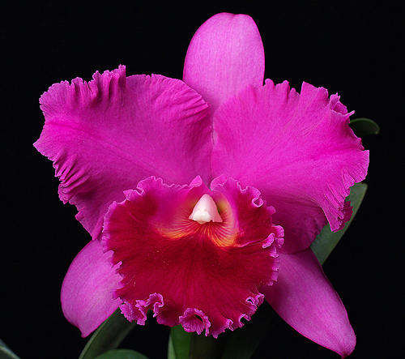
Don’t ever take away someone’s hope, it may be all they have to hold on to.

Slide 4
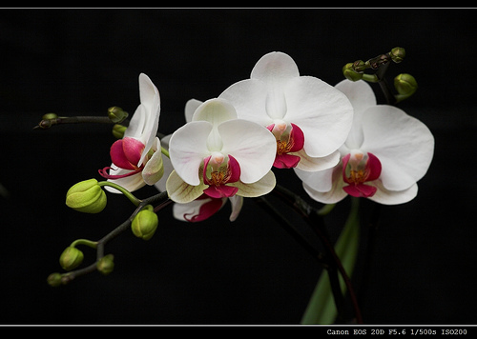
Don’t make decisions when you are angry.

Slide 5
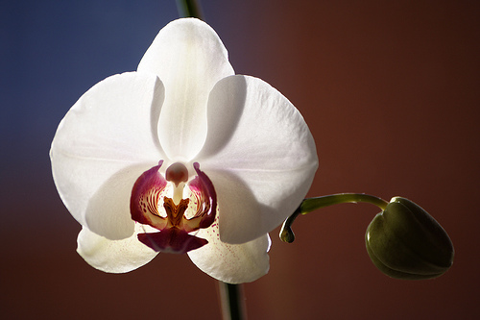
Take care of your physical body

Slide 6
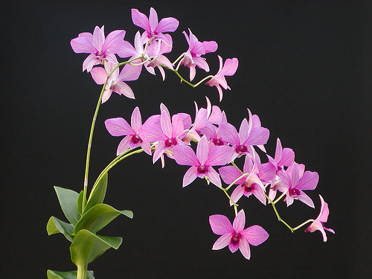
Don’t pay for a job until it is finished.

Slide 7

Be careful of those who have nothing to lose.

Slide 8

Learn to say “no”, but do so with kindness and caring.

Slide 9
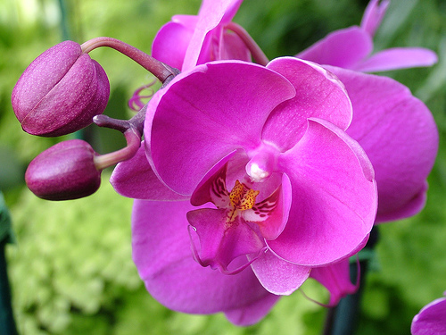
Don’t expect life to be fair.

Slide 10
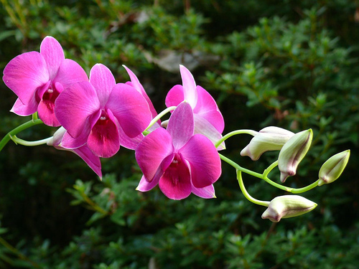
Don’t be worried about losing a battle, if this helps you win the war.

Slide 11
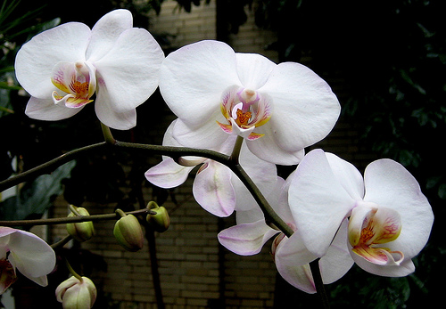
Don’t put things off. Do what is needed to be done in the moment.

Slide 12
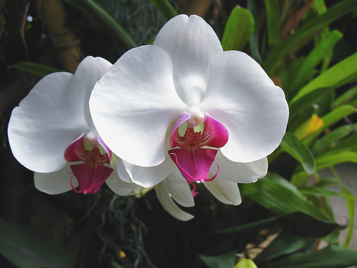
Don’t be afraid of saying, “I don’t know” or “I am sorry”.

Slide 13

Contemplate the dawn hours at least once a year.

Slide 14

Look into the eyes of people.

Slide 15

Loneliness is a state of mind. You don’t need other people to love yourself.

Slide 16
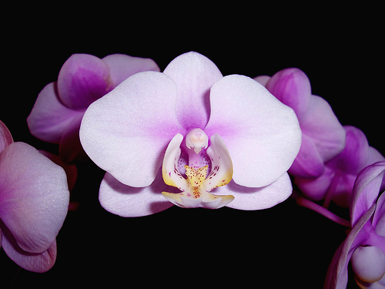
There is nothing good or bad in life, it is all about choices…So choose wisely

Slide 17
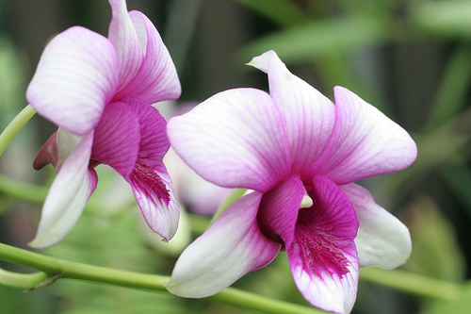
Treat everyone as you would like to be treated..

Slide 18
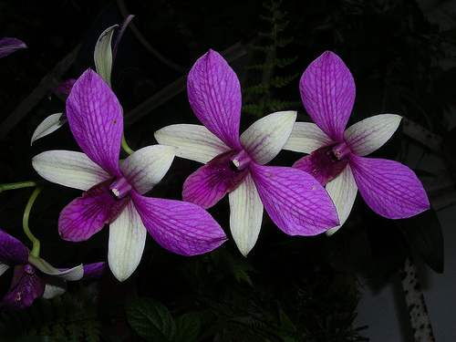
Live in the moment. Don’t rush ahead… There is much to taste of life in the “now”.

Slide 19
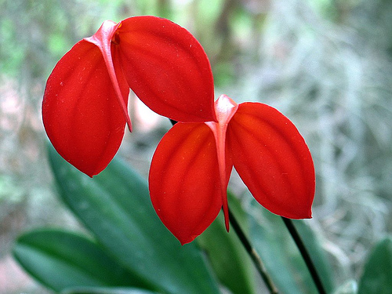
Don’t be so hard on yourself. You’ve come to this life to learn all about who you are. So enjoy the experience.

Slide 20
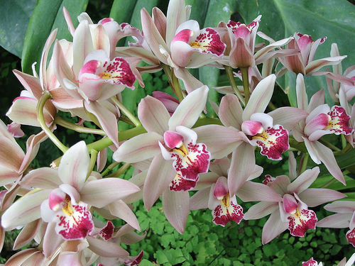
Always tell the truth.
z.

Slide 21
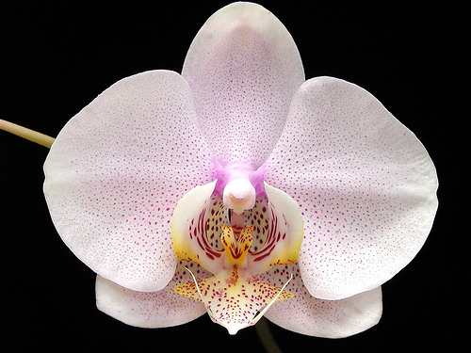
Don’t believe all that you hear and don’t say all that you think.

Slide 22

Much of your growth as a person will come through hardships and challenges. Embrace those and know you will be better, stronger and wiser because of them.

Slide 23
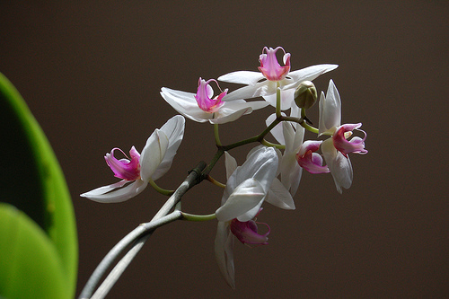
Learn to listen, it is an art.

Slide 24
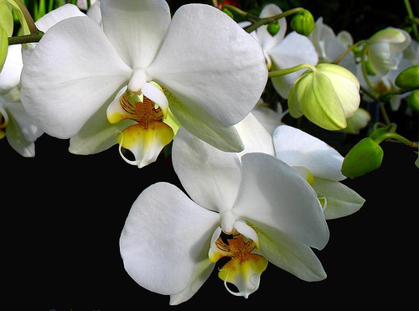
Life is all about energy. Try to feel it around you, through you and in you. Distinguish the positive from the negative.

Slide 25
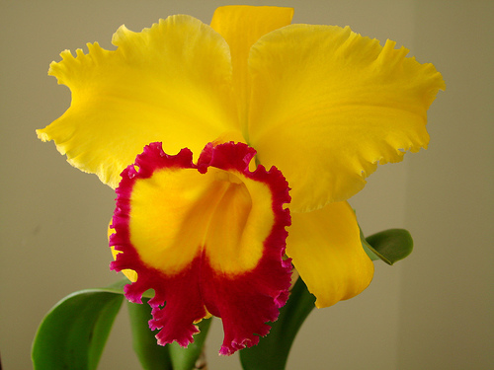
Enjoy the beauty of this Earth all around you.

Slide 26
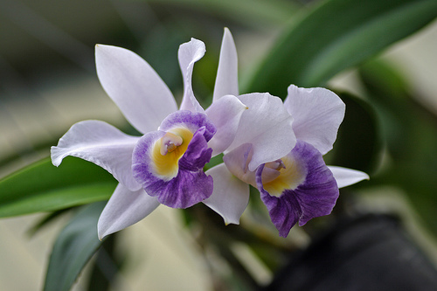
Choose your partner well, for there is derived a lot of happiness.

Slide 27
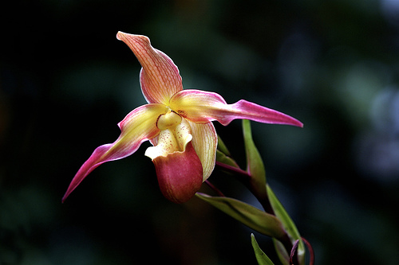
Don’t get out of control at any time, breathe deeply.

Slide 28
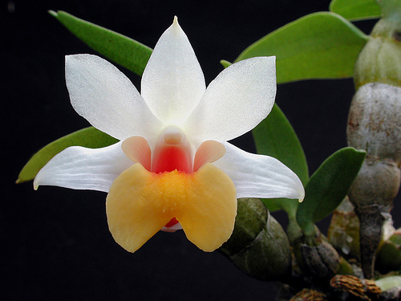
There are no coincidences and no accidents in life. Everything big and small is for a reason. Pay careful attention.

Slide 29
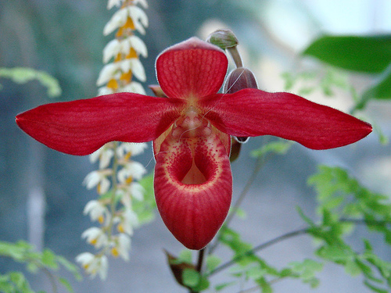
Meditate at least thirty minutes a day.

Slide 30
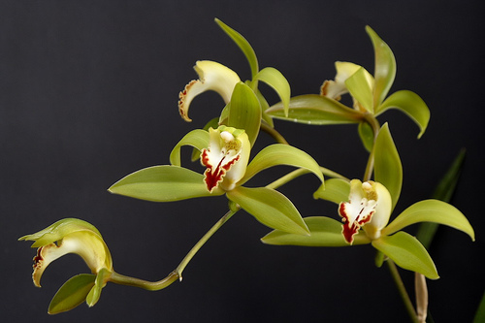
Enjoy times of rest.

Slide 31
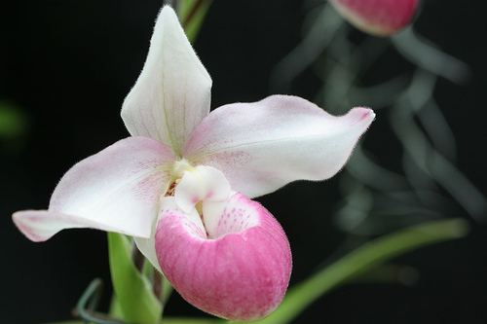
Nurture and maintain your friendships

Slide 32
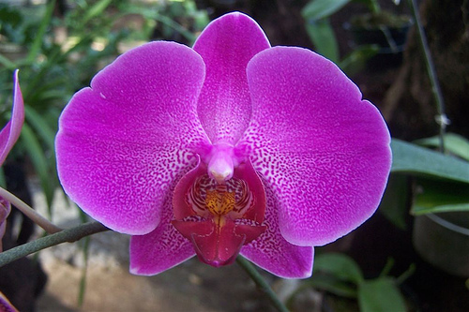
Live more in your heart and less in your head.

Slide 33
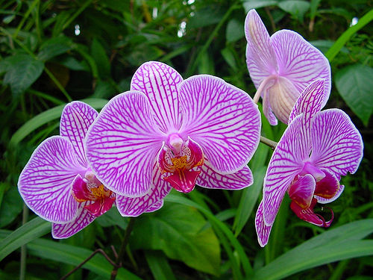
You have a right to be happy!

Slide 34

Ged rid of hatred and bitterness, they do you more harm.

Slide 35
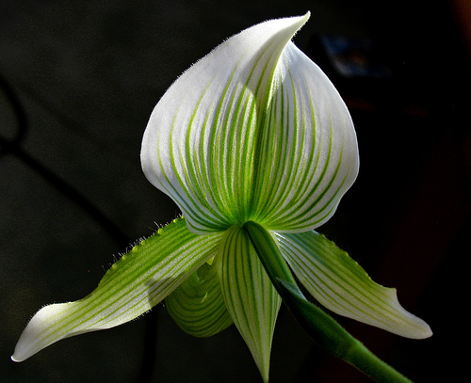
There are those things in life that can never be recaptured: the spoken word, time passed and opportunities.

Slide 36
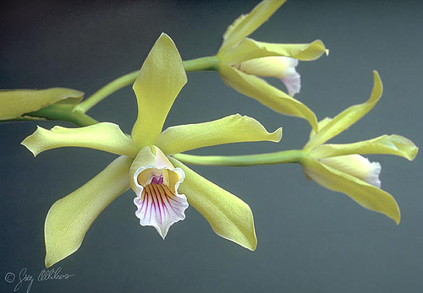
Do one thing at a time and do it well.

Slide 37
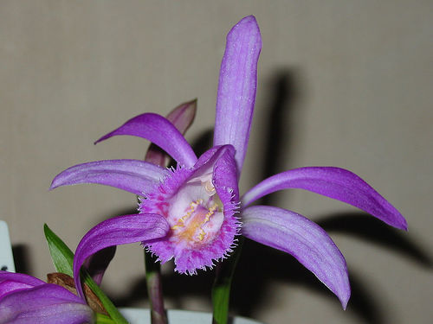
There are two dominant energies in life, love and fear. Love overcomes all. Stay out of fear. There is nothing to fear, it only brings chaos.

Slide 38

Love your body. It knows what you think. From your emotions spring health or illness. Send yourself positive thoughts all the time..

Slide 39
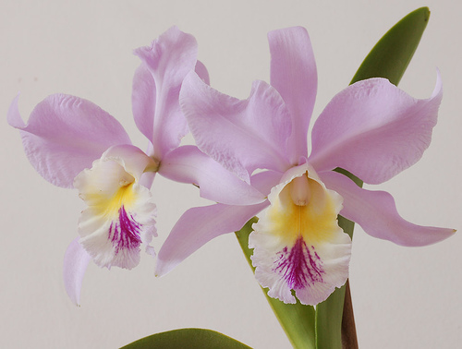
Be thoughtful and careful what comes out of your mouth since with those words you create your reality.

Slide 40
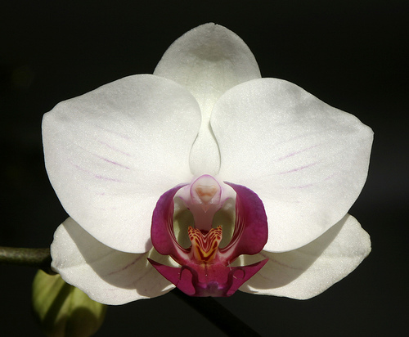
One day you will look back over all that you did in this life and you will die with laughter…
SURROUND YOURSELF WITH LIGHT EVERYDAY!

